Slide 1



Noida Institute of Engineering and Technology, Greater Noida
Graphs and File Structure
Unit: 5
Data Structure and Algorithms
Alisha Sikri
Assistant Professor
(AI-ML)
Course Details (B Tech (AIML) 3rd Sem)

Slide 2
Content
File: Organization (Sequential, Direct, Indexed Sequential, Hashed)
Various types of accessing schemes
Graph: Basic Terminologies
Representations
Operations and Applications of Graphs
Graph search and traversal algorithms
Complexity analysis

Slide 3
Unit Objective
After completion of this unit, students will be able to -
To study various file organization techniques (Sequential, Direct, Indexed Sequential, Hashed)
To study various types of accessing schemes
To understand the basic terminology and different types of graph
To understand the concept of graph representation, graph traversal and concept of minimum cost spanning trees
To understand the shortest path algorithms and its implementation

Slide 4
Course Outcome
CO | CO Description | Bloom’s Knowledge Level (KL)
CO1 | Describe the need of data structure and algorithms in problem solving and analyze Time space trade-off. | K2, K4
CO2 | Describe how arrays are represented in memory and how to use them for implementation of matrix operations, searching and sorting along with their computational efficiency. | K2, K6
CO3 | Design, implement and evaluate the real-world applications using stacks, queues and non-linear data structures. | K5, K6
CO4 | Compare and contrast the advantages and disadvantages of linked lists over arrays and implement operations on different types of linked list. | K4, K6
CO5 | Identify and develop the alternative implementations of data structures with respect to its performance to solve a real-world problem. | K1, K3, K5, K6

Slide 5
CO-PO Mapping
CO-PO correlation matrix of Data Structure and Algorithms (ACSBS 0203)
 | PO1 | PO2 | PO3 | PO4 | PO5 | PO6 | PO7 | PO8 | PO9 | PO10 | PO11 | PO12
ACSBS0203.1 | 3 | 3 | 3 | 2 | - | 1 | - | 1 | 2 | 2 | 2 | 2
ACSBS0203.2 | 3 | 3 | 2 | 2 | - | 1 | - | 1 | 2 | 2 | 1 | 2
ACSBS0203.3 | 3 | 3 | 2 | 2 | - | 1 | - | 1 | 2 | 2 | 2 | 2
ACSBS0203.4 | 3 | 3 | 2 | 2 | - | 1 | - | 1 | 2 | 2 | 2 | 2
ACSBS0203.5 | 3 | 3 | 3 | 3 | 2 | 2 | 2 | 2 | 3 | 3 | 3 | 3
Average | 3.0 | 3.0 | 2.4 | 2.2 | 0.4 | 1.2 | 0.4 | 1.2 | 2.2 | 2.2 | 2.0 | 2.2

Slide 6
Prerequisite and Recap
Familiar with programming language ‘python’
Learn to implement Data Structure using array and Linked list

Slide 7
Unit V Syllabus
Graphs: Terminology used with Graph, Data Structure for Graph Representations: Adjacency matrices, Adjacency List.
Graph Traversal: Depth First Search and Breadth First Search. Connected Component, Spanning Trees, Minimum Cost Spanning Trees: Prim’ s and Kruskal’s algorithm. Transitive Closure and Shortest Path algorithms: Dijkstra Algorithm.
File Structure: Concepts of files, records and files, Sequential, Indexed and Random File Organization, Indexing structure for index files, hashing for direct files, Multi-Key file organization and Access Methods.

Slide 8
Topic Objective
To understand the basic terminology and different types of files.
To understand the concept of file, and different type of file organization.

Slide 9
What is File? (CO5)
File is a collection of records related to each other. The file size is limited by the size of memory and storage medium.

Slide 10
Records and file (CO5)
Record– It is a collection of units of information about a particular entity. Passenger of an airplane, an employee of an organization, or an article sold from a store.
File-A collection of records involving a set of entities with certain aspects in common and organized for some particular purpose is called a file. For example collection of records of all passengers.

Slide 11
File Organization (CO5)
File Organization refers to the logical relationships among various records that constitute the file, particularly with respect to the means of identification and access to any specific record.
In simple terms, Storing the files in certain order is called file Organization.
File Structure refers to the format of the label and data blocks and of any logical control record.

Slide 12
Types of File Organization (CO5)
There are three types of organizing the file:
1. Sequential access file organization 2. Direct access file organization 3. Indexed sequential access file organization

Slide 13
Sequential access file organization (CO5)
Storing and sorting in contiguous block within files on tape or disk is called as sequential access file organization.
In sequential access file organization, all records are stored in a sequential order. The records are arranged in the ascending or descending order of a key field.
Sequential file search starts from the beginning of the file and the records can be added at the end of the file.
In sequential file, it is not possible to add a record in the middle of the file without rewriting the file.

Slide 14
Sequential access file organization (CO5)
Advantages of sequential file –
It is simple to program and easy to design.
Sequential file is best use if storage space.
Disadvantages of sequential file –
Sequential file is time consuming process.
It has high data redundancy.
Random searching is not possible.

Slide 15
Direct access file organization (CO5)
Direct access file is also known as random access or relative file organization.
In direct access file, all records are stored in direct access storage device (DASD), such as hard disk. The records are randomly placed throughout the file.
The records does not need to be in sequence because they are updated directly and rewritten back in the same location.
This file organization is useful for immediate access to large amount of information. It is used in accessing large databases.
It is also called as hashing.

Slide 16
Direct access file organization(CO5)
Advantages of direct access file organization –
Direct access file helps in online transaction processing system (OLTP) like online railway reservation system.
In direct access file, sorting of the records are not required.
It accesses the desired records immediately.
It updates several files quickly.
It has better control over record allocation.
Disadvantages of direct access file organization –
Direct access file does not provide back up facility.
It is expensive.
It has less storage space as compared to sequential file.

Slide 17
Indexed sequential access file organization(CO5)
Indexed sequential access file combines both sequential file and direct access file organization.
In indexed sequential access file, records are stored randomly on a direct access device such as magnetic disk by a primary key.
This file have multiple keys. These keys can be alphanumeric in which the records are ordered is called primary key.
The data can be access either sequentially or randomly using the index. The index is stored in a file and read into memory when the file is opened.

Slide 18
Indexed sequential access file organization(CO5)
Advantages of Indexed sequential access file organization –
In indexed sequential access file, sequential file and random file access is possible.
It accesses the records very fast if the index table is properly organized.
The records can be inserted in the middle of the file.
It provides quick access for sequential and direct processing.
It reduces the degree of the sequential search.

Slide 19
Indexed sequential access file organization(CO5)
Disadvantages of Indexed sequential access file organization –
Indexed sequential access file requires unique keys and periodic reorganization.
Indexed sequential access file takes longer time to search the index for the data access or retrieval.
It requires more storage space.
It is expensive because it requires special software.
It is less efficient in the use of storage space as compared to other file organizations.

Slide 20
Daily Quiz
What are various file organization techniques?
2. In the index allocation scheme of blocks to a file, the maximum possible size of the file depends on : (A) the size of the blocks, and the size of the ad­dress of the blocks. (B) the number of blocks used for the index, and the size of the blocks. (C) the size of the blocks, the number of blocks used for the index, and the size of the address of the blocks. (D) None of these
3. The physical location of a record determined by a formula that transforms a file key into a record location is (A) Hashed file (B) B-Tree file (C) Indexed file (D) Sequential file

Slide 21
Daily Quiz
4. The physical location of a record determined by a formula that transforms a file key into a record location is
(A) Hashed file (B) B-Tree file (C) Indexed file (D) Sequential file
5. The file organization which allows us to read records that would satisfy the join condition by using one block read is
a) Heap file organization b) Sequential file organization c) Clustering file organization d) Hash file organization

Slide 22
Topic Objective
The students will understand the basic terminology and different types of graphs and also will be able to understand the concept of graph representation, graph traversal and concept of minimum cost spanning trees.

Slide 23
Graphs (CO5)
Introduction to Graphs
Graph is a non-linear data structure. It contains a set of points known as nodes (or vertices) and a set of links known as edges (or Arcs). Here edges are used to connect the vertices. A graph is defined as follows...
Graph is a collection of vertices and arcs in which vertices are connected with arcs
or
Graph is a collection of nodes and edges in which nodes are connected with edges
Generally, a graph G is represented as G = ( V , E ), where V is set of vertices and E is set of edges.

Slide 24
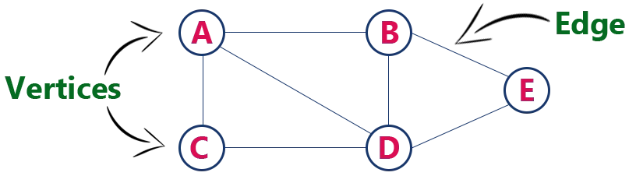
Graphs (CO5)
Example
The following is a graph with 5 vertices and 6 edges. This graph G can be defined as G = ( V , E )
Where V = {A,B,C,D,E} and E = {(A,B),(A,C)(A,D),(B,D),(C,D),(B,E), (E,D)}.

Slide 25
Graphs (CO5)
Graph Terminology
We use the following terms in graph data structure...
Vertex
Individual data element of a graph is called as Vertex. Vertex is also known as node. In above example graph, A, B, C, D & E are known as vertices.
Edge
An edge is a connecting link between two vertices. Edge is also known as Arc. An edge is represented as (startingVertex, endingVertex). For example, in above graph the link between vertices A and B is represented as (A,B). In above example graph, there are 7 edges (i.e., (A,B), (A,C), (A,D), (B,D), (B,E), (C,D), (D,E)).

Slide 26
Graphs (CO5)
Edges are three types.
Undirected Edge - An undirected egde is a bidirectional edge. If there is undirected edge between vertices A and B then edge (A , B) is equal to edge (B , A).
Directed Edge - A directed egde is a unidirectional edge. If there is directed edge between vertices A and B then edge (A , B) is not equal to edge (B , A).
Weighted Edge - A weighted egde is a edge with value (cost) on it.

Slide 27
Graphs (CO5)
Undirected Graph
A graph with only undirected edges is said to be undirected graph.
Directed Graph
A graph with only directed edges is said to be directed graph.
Mixed Graph
A graph with both undirected and directed edges is said to be mixed graph.
End vertices or Endpoints
The two vertices joined by edge are called end vertices (or endpoints) of that edge.

Slide 28
Graphs (CO5)
Origin
If a edge is directed, its first endpoint is said to be the origin of it.
Destination
If a edge is directed, its first endpoint is said to be the origin of it and the other endpoint is said to be the destination of that edge.
Adjacent
If there is an edge between vertices A and B then both A and B are said to be adjacent. In other words, vertices A and B are said to be adjacent if there is an edge between them.

Slide 29
Graphs (CO5)
Incident
Edge is said to be incident on a vertex if the vertex is one of the endpoints of that edge.
Outgoing Edge
A directed edge is said to be outgoing edge on its origin vertex.
Incoming Edge
A directed edge is said to be incoming edge on its destination vertex.
Degree
Total number of edges connected to a vertex is said to be degree of that vertex.

Slide 30
Graphs (CO5)
Indegree
Total number of incoming edges connected to a vertex is said to be indegree of that vertex.
Outdegree
Total number of outgoing edges connected to a vertex is said to be outdegree of that vertex.
Parallel edges or Multiple edges
If there are two undirected edges with same end vertices and two directed edges with same origin and destination, such edges are called parallel edges or multiple edges.

Slide 31
Graphs (CO5)
Self-loop
Edge (undirected or directed) is a self-loop if its two endpoints coincide with each other.
Simple Graph
A graph is said to be simple if there are no parallel and self-loop edges.
Path
A path is a sequence of alternate vertices and edges that starts at a vertex and ends at other vertex such that each edge is incident to its predecessor and successor vertex.

Slide 32
Graphs (CO5)
Graph Representations
Graph data structure is represented using following representations...
Adjacency Matrix
Incidence Matrix
Adjacency List

Slide 33
Graphs (CO5)
Adjacency Matrix
In this representation, the graph is represented using a matrix of size total number of vertices by a total number of vertices.
That means a graph with 4 vertices is represented using a matrix of size 4X4.
In this matrix, both rows and columns represent vertices.
This matrix is filled with either 1 or 0.
Here, 1 represents that there is an edge from row vertex to column vertex and 0 represents that there is no edge from row vertex to column vertex.

Slide 34
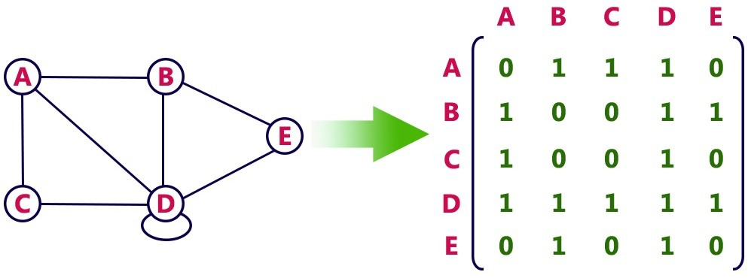
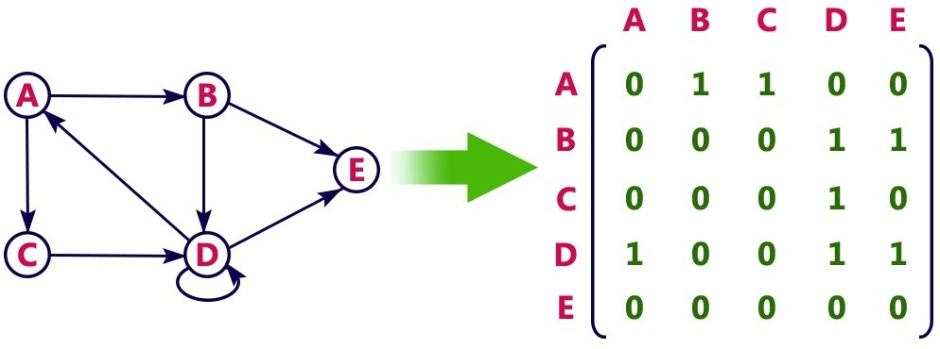
Undirected graph representation...
Graphs (CO5)
Directed graph representation...

Slide 35
Graphs (CO5)
Incidence Matrix
In this representation, the graph is represented using a matrix of size total number of vertices by a total number of edges.
That means graph with 4 vertices and 6 edges is represented using a matrix of size 4X6.
In this matrix, rows represent vertices and columns represents edges. This matrix is filled with 0 or 1 or -1.

Slide 36
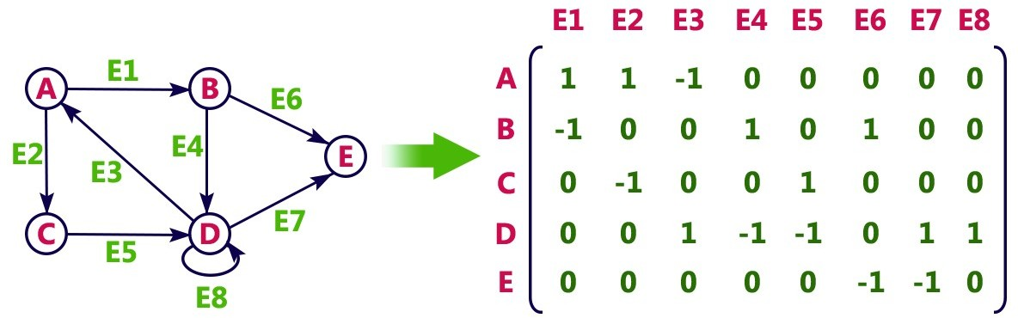
Graphs (CO5)
Incidence Matrix
Here, 0 represents that the row edge is not connected to column vertex
1 represents that the row edge is connected as the outgoing edge to column vertex and -1 represents that the row edge is connected as the incoming edge to column vertex.
For example, consider the following directed graph representation...

Slide 37
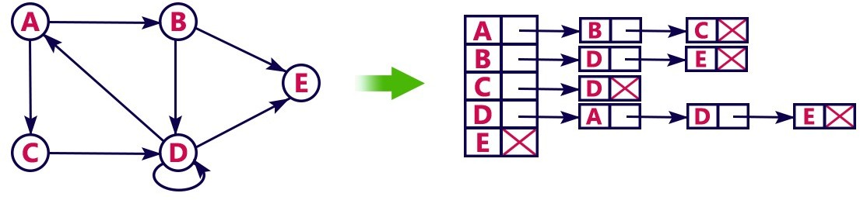
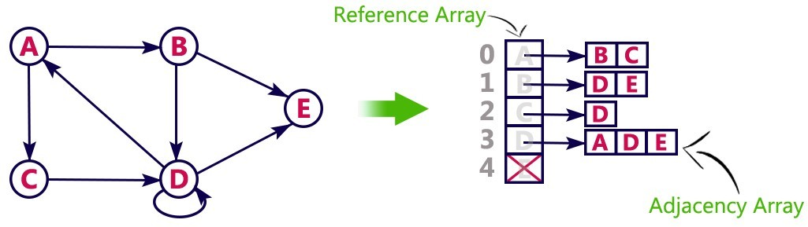
Graphs (CO5)
Adjacency List
In this representation, every vertex of a graph contains list of its adjacent vertices.
For example, consider the following directed graph representation implemented using linked list...
This representation can also be implemented using an array as follows..

Slide 38
Graphs (CO5)
Graph Traversal – DFS
Graph traversal is a technique used for a searching vertex in a graph. The graph traversal is also used to decide the order of vertices is visited in the search process. A graph traversal finds the edges to be used in the search process without creating loops. That means using graph traversal we visit all the vertices of the graph without getting into looping path.
There are two graph traversal techniques and they are as follows...
DFS (Depth First Search)
BFS (Breadth First Search)

Slide 39
Graphs (CO5)
DFS (Depth First Search)
DFS traversal of a graph produces a spanning tree as final result. Spanning Tree is a graph without loops.
We use Stack data structure with maximum size of total number of vertices in the graph to implement DFS traversal.

Slide 40
Graphs (CO5)
DFS (Depth First Search)
We use the following steps to implement DFS traversal...
Step 1 - Define a Stack of size total number of vertices in the graph.
Step 2 - Select any vertex as starting point for traversal. Visit that vertex and push it on to the Stack.
Step 3 - Visit any one of the non-visited adjacent vertices of a vertex which is at the top of stack and push it on to the stack.

Slide 41
Graphs (CO5)
Step 4 - Repeat step 3 until there is no new vertex to be visited from the vertex which is at the top of the stack.
Step 5 - When there is no new vertex to visit then use back tracking and pop one vertex from the stack.
Step 6 - Repeat steps 3, 4 and 5 until stack becomes Empty.
Step 7 - When stack becomes Empty, then produce final spanning tree by removing unused edges from the graph

Slide 42
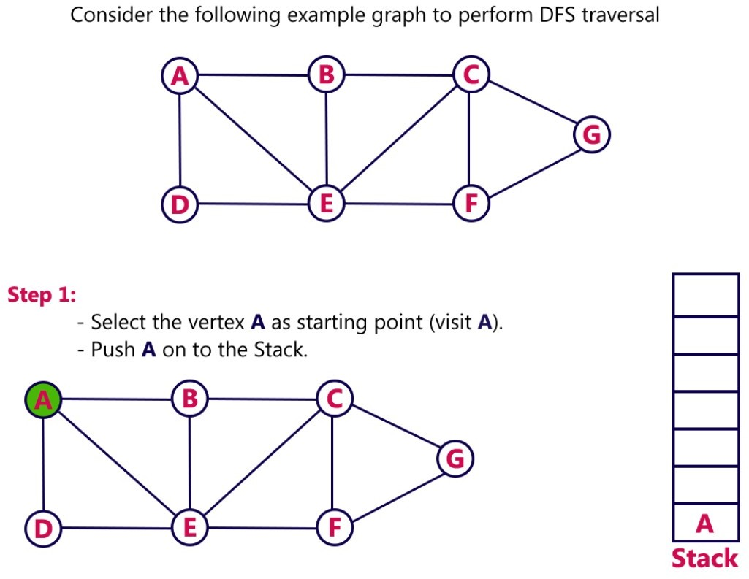
Example
Graphs (CO5)

Slide 43
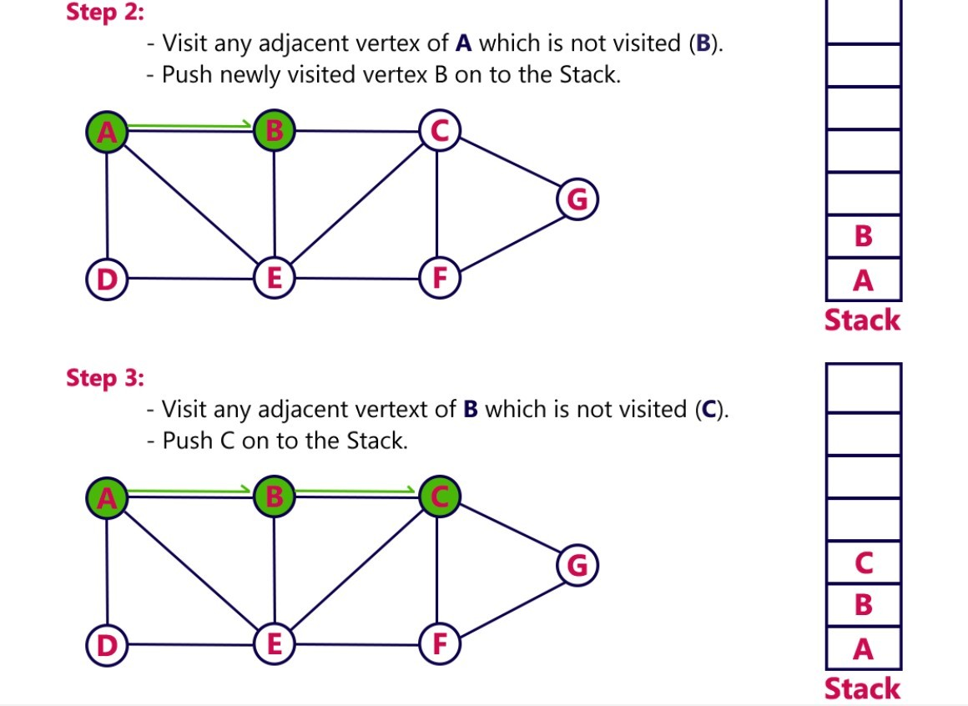
Graphs (CO5)

Slide 44
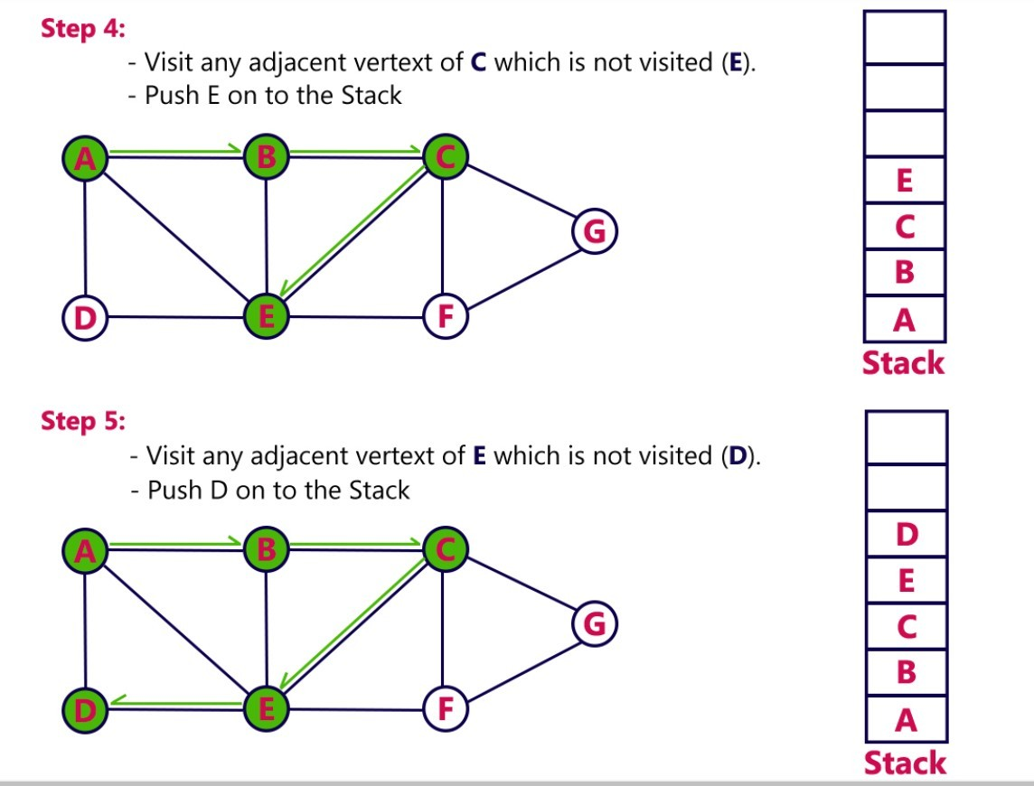
Graphs (CO5)

Slide 45
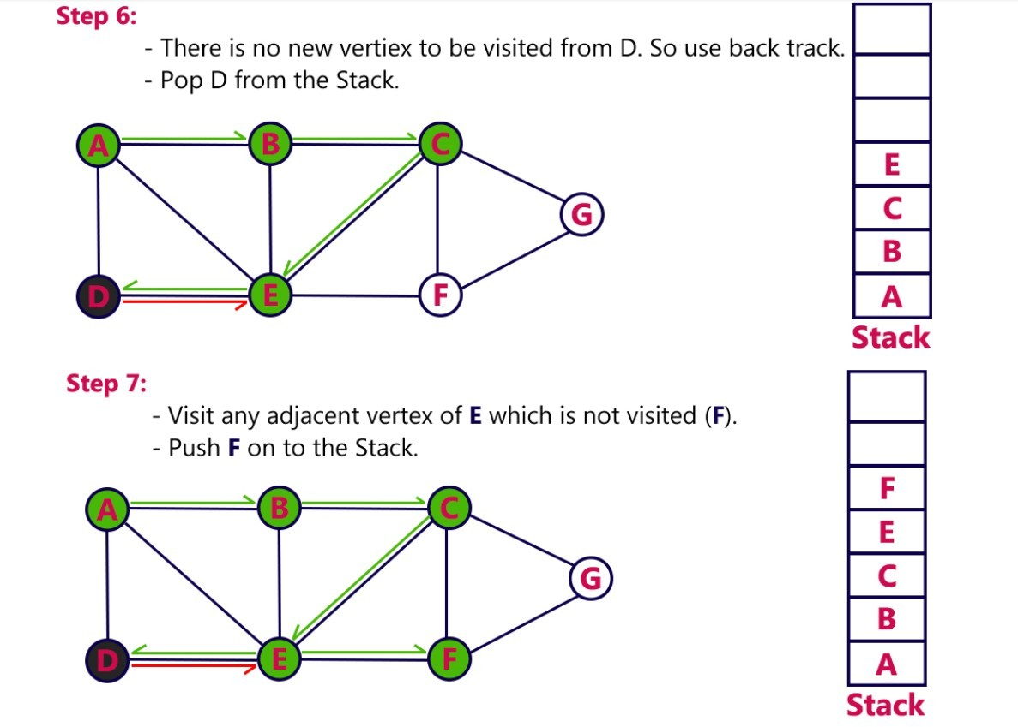
Graphs (CO5)

Slide 46
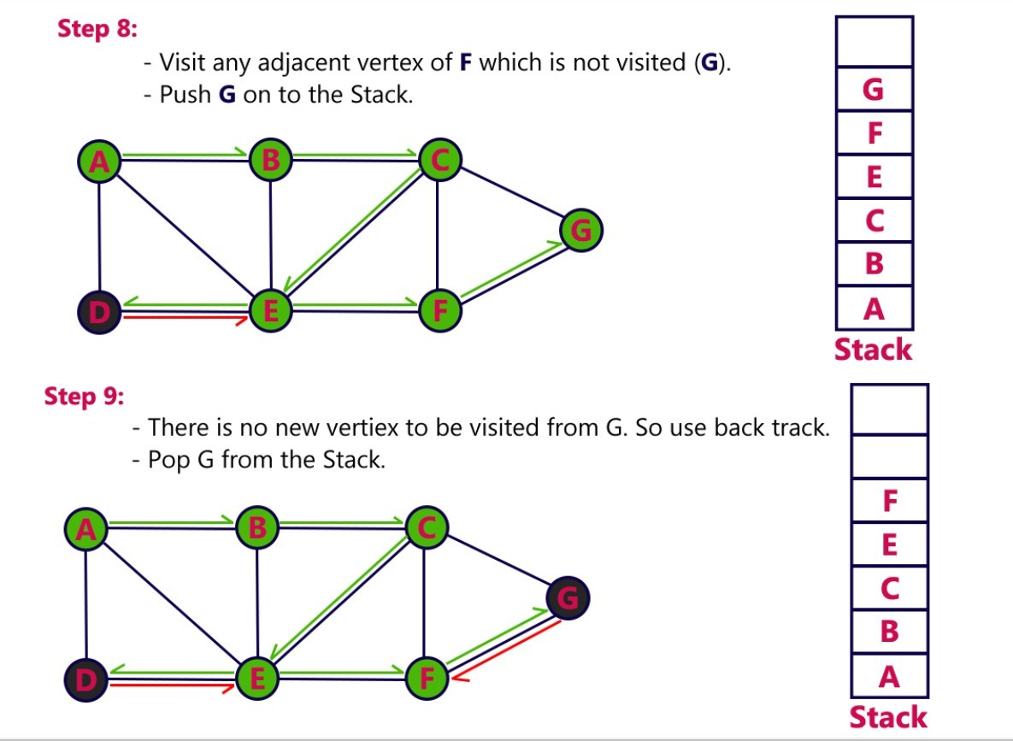
Graphs (CO5)

Slide 47
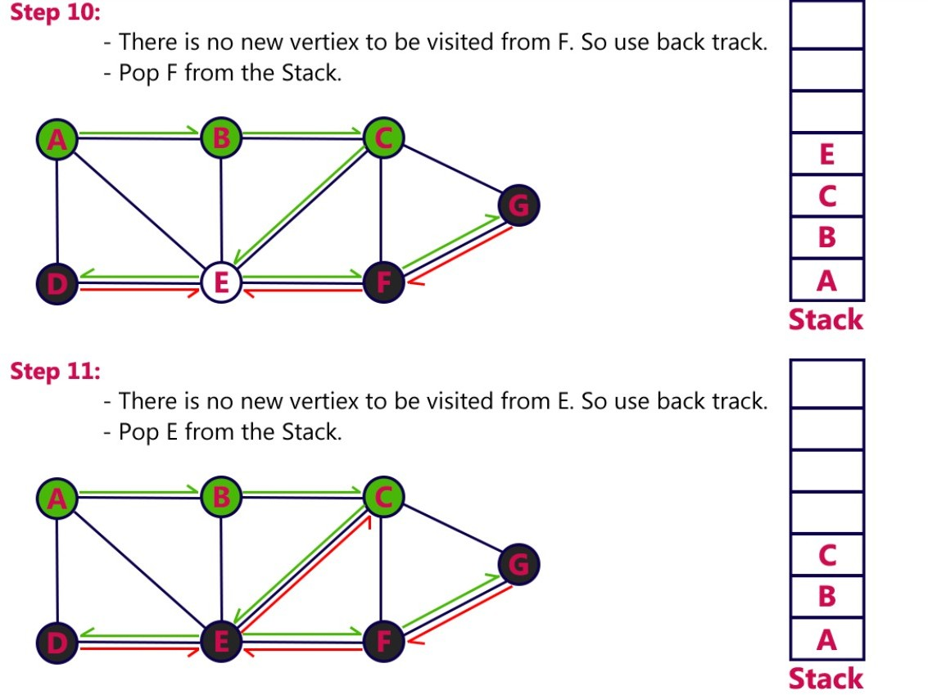
Graphs (CO5)

Slide 48
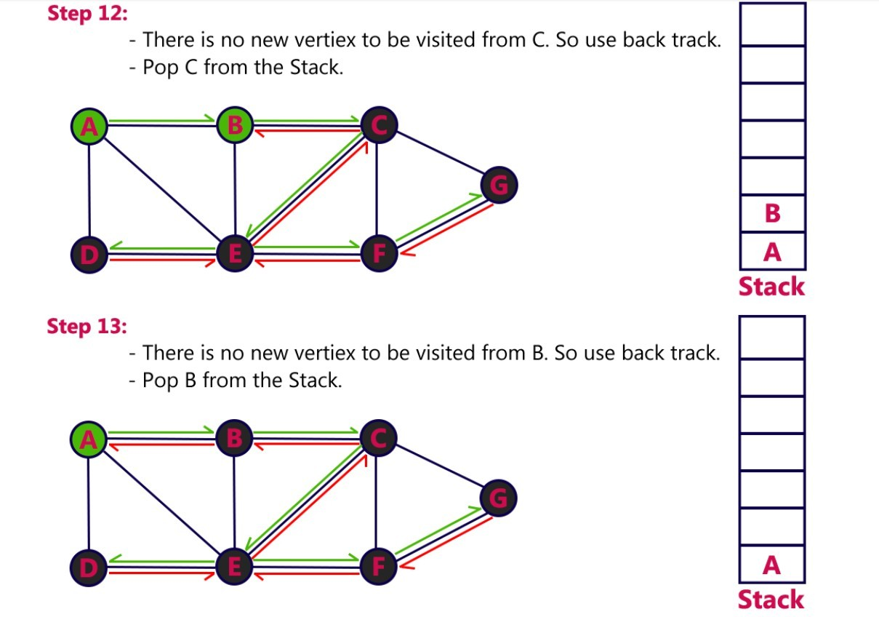
Graphs (CO5)

Slide 49
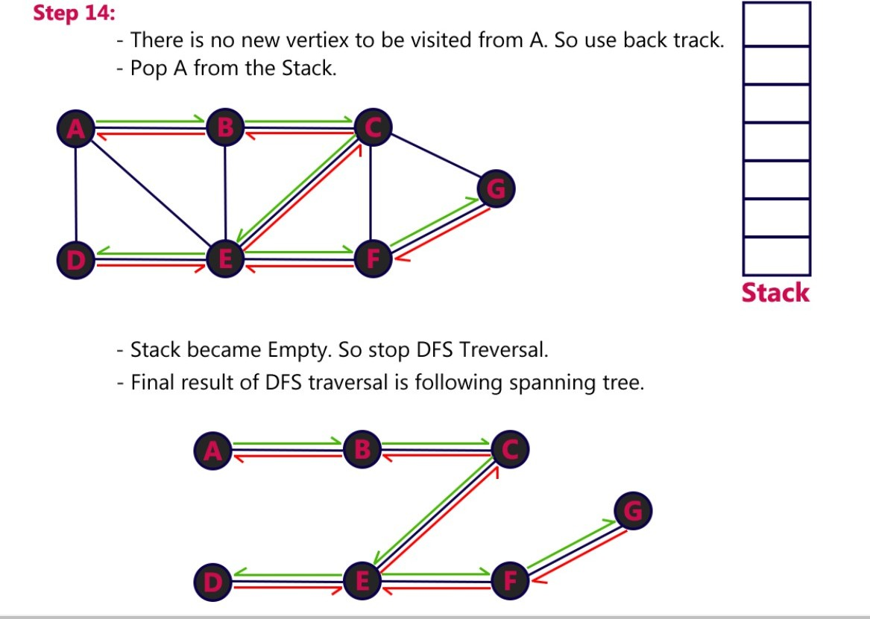
Graphs (CO5)

Slide 50
Graphs (CO5)
Graph Traversal – BFS
Graph traversal is a technique used for searching a vertex in a graph. The graph traversal is also used to decide the order of vertices is visited in the search process.
A graph traversal finds the edges to be used in the search process without creating loops. That means using graph traversal we visit all the vertices of the graph without getting into looping path.
There are two graph traversal techniques and they are as follows...
DFS (Depth First Search)
BFS (Breadth First Search)

Slide 51
Graphs (CO5)
BFS (Breadth First Search)
BFS traversal of a graph produces a spanning tree as final result. Spanning Tree is a graph without loops. We use Queue data structure with maximum size of total number of vertices in the graph to implement BFS traversal.
We use the following steps to implement BFS traversal...
Step 1 - Define a Queue of size total number of vertices in the graph.
Step 2 - Select any vertex as starting point for traversal. Visit that vertex and insert it into the Queue.

Slide 52
Graphs (CO5)
Step 3 - Visit all the non-visited adjacent vertices of the vertex which is at front of the Queue and insert them into the Queue.
Step 4 - When there is no new vertex to be visited from the vertex which is at front of the Queue then delete that vertex.
Step 5 - Repeat steps 3 and 4 until queue becomes empty.
Step 6 - When queue becomes empty, then produce final spanning tree by removing unused edges from the graph.

Slide 53
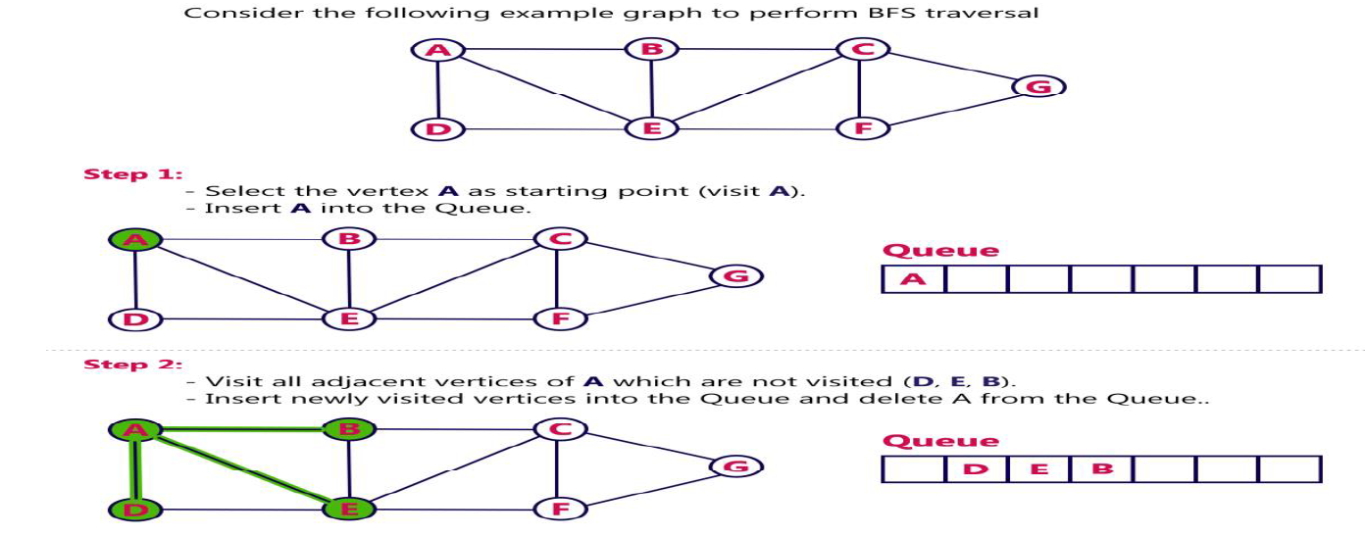
Graphs (CO5)

Slide 54
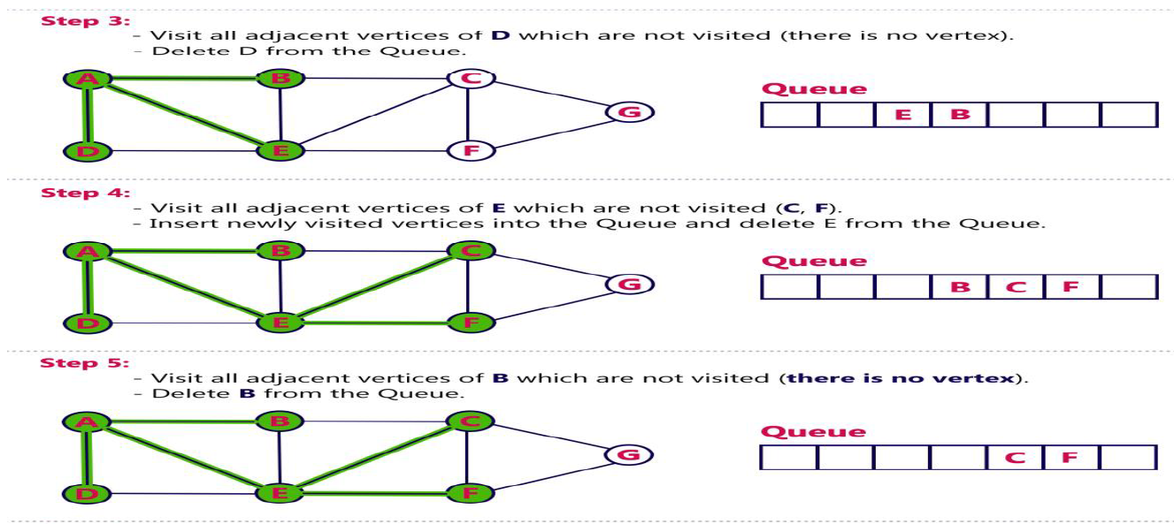
Graphs (CO5)

Slide 55
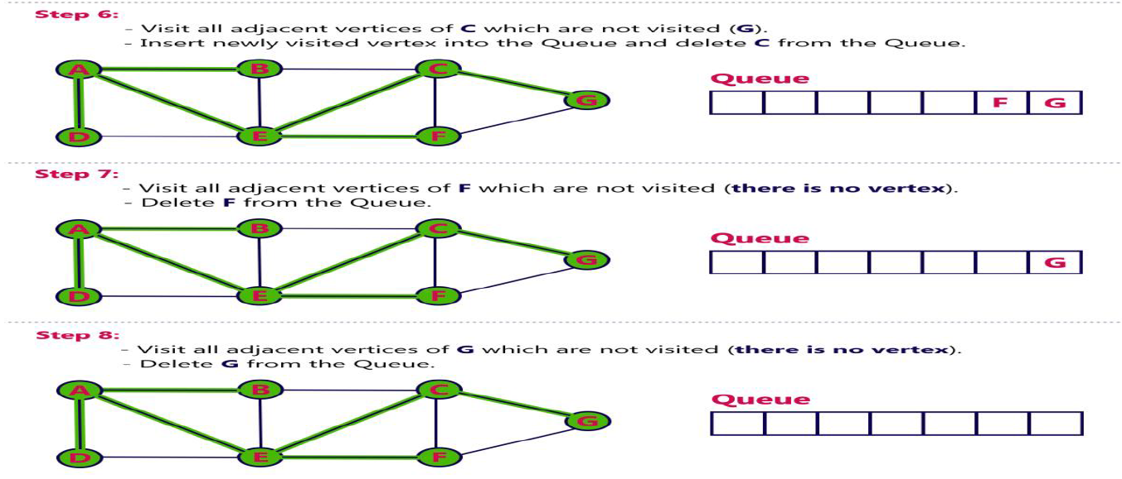
Graphs (CO5)

Slide 56
Graphs (CO5)
Queue became Empty, So, stop the BFS process.
Final result of BFS is a Spanning tree as shown below

Slide 57
Graphs (CO5)
Spanning Tree
Spanning tree can be defined as a sub-graph of connected, undirected graph G that is a tree produced by removing the desired number of edges from a graph.
In other words, Spanning tree is a non-cyclic sub-graph of a connected and undirected graph G that connects all the vertices together.
A graph G can have multiple spanning trees.

Slide 58
Graphs (CO5)
Spanning Tree
Minimum Spanning Tree
There can be weights assigned to every edge in a weighted graph.
However, A minimum spanning tree is a spanning tree which has minimal total weight.
In other words, minimum spanning tree is the one which contains the least weight among all other spanning tree of some particular graph.

Slide 59
Graphs (CO5)
Shortest path algorithms
In this section of the tutorial, we will discuss the algorithms to calculate the shortest path between two nodes in a graph.
There are two algorithms which are being used for this purpose.
Prim's Algorithm
Kruskal's Algorithm

Slide 60
Graphs (CO5)
Shortest path algorithms
Prim's Algorithm
Prim's Algorithm is used to find the minimum spanning tree from a graph. Prim's algorithm finds the subset of edges that includes every vertex of the graph such that the sum of the weights of the edges can be minimized.
Prim's algorithm starts with the single node and explore all the adjacent nodes with all the connecting edges at every step. The edges with the minimal weights causing no cycles in the graph got selected.

Slide 61
Graphs (CO5)
Prim's Algorithm
The algorithm is given as follows.
Algorithm
Step 1: Select a starting vertex
Step 2: Repeat Steps 3 and 4 until there are fringe vertices
Step 3: Select an edge e connecting the tree vertex and fringe vertex that has minimum weight
Step 4: Add the selected edge and the vertex to the minimum spanning tree T
[END OF LOOP]
Step 5: EXIT

Slide 62
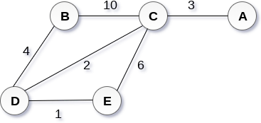
Graphs (CO5)
Example :
Construct a minimum spanning tree of the graph given in the following figure by using prim's algorithm.
Solution
Step 1 : Choose a starting vertex B.
Step 2: Add the vertices that are adjacent to A. the edges that connecting the vertices are shown by dotted lines.

Slide 63
Graphs (CO5)
Step 3: Choose the edge with the minimum weight among all. i.e. BD and add it to MST. Add the adjacent vertices of D i.e. C and E.
Step 3: Choose the edge with the minimum weight among all. In this case, the edges DE and CD are such edges. Add them to MST and explore the adjacent of C i.e. E and A.
Step 4: Choose the edge with the minimum weight i.e. CA. We can't choose CE as it would cause cycle in the graph.
The graph produces in the step 4 is the minimum spanning tree of the graph shown in the above figure.
The cost of MST will be calculated as; cost(MST) =
4 + 2 + 1 + 3 = 10 units.

Slide 64
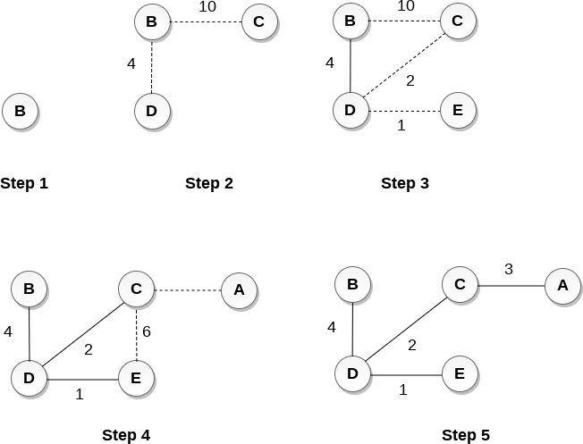
Graphs (CO5)

Slide 65
Graphs (CO5)
Kruskal's Algorithm
Kruskal's Algorithm is used to find the minimum spanning tree for a connected weighted graph.
The main target of the algorithm is to find the subset of edges by using which, we can traverse every vertex of the graph.
Kruskal's algorithm follows greedy approach which finds an optimum solution at every stage instead of focusing on a global optimum.

Slide 66
Graphs (CO5)
The Kruskal's algorithm is given as follows.
Algorithm
Step 1: Create a forest in such a way that each graph is a separate tree.
Step 2: Create a priority queue Q that contains all the edges of the graph.
Step 3: Repeat Steps 4 and 5 while Q is NOT EMPTY

Slide 67
Graphs (CO5)
Step 4: Remove an edge from Q
Step 5: IF the edge obtained in Step 4 connects two different trees, then Add it to the forest (for combining two trees into one tree).
ELSE
Discard the edge
Step 6: END

Slide 68
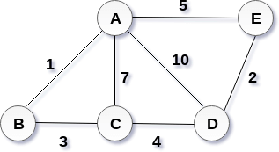
Graphs (CO5)
Example :
Apply the Kruskal's algorithm on the graph given as follows.
Solution:
the weight of the edges given as:
Edge | AE | AD | AC | AB | BC | CD | DE
Weight | 5 | 10 | 7 | 1 | 3 | 4 | 2

Slide 69
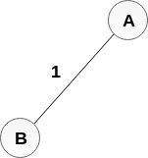
Graphs (CO5)
Sort the edges according to their weights.
Edge | AB | DE | BC | CD | AE | AC | AD
Weight | 1 | 2 | 3 | 4 | 5 | 7 | 10
Start constructing the tree; Add AB to the MST;
Add DE to the MST;

Slide 70
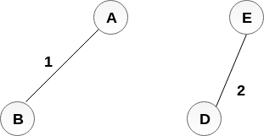
Add BC to the MST;
Graphs (CO5)

Slide 71
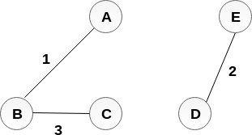
Graphs (CO5)
The next step is to add AE, but we can't add that as it will cause a cycle.
The next edge to be added is AC, but it can't be added as it will cause a cycle.
The next edge to be added is AD, but it can't be added as it will contain a cycle.
Hence, the final MST is the one which is shown in the step 4. the cost of MST = 1 + 2 + 3 + 4 = 10.

Slide 72
Daily Quiz
1. Which of the following statements for a simple graph is correct? A. Every path is a trail B. Every trail is a path C. Every trail is a path as well as every path is a trail D. None of the mentioned
2. Which of the following is an advantage of adjacency list representation over adjacency matrix representation of a graph? A. In adjacency list representation, space is saved for sparse graphs. B. DFS and BSF can be done in O(V + E) time for adjacency list representation. These operations take O(V^2) time in adjacency matrix representation. Here is V and E are number of vertices and edges respectively. C. Adding a vertex in adjacency list representation is easier than adjacency matrix representation. D. All of the above

Slide 73
Daily Quiz
3. On which of the following statements does the time complexity of checking if an edge exists between two particular vertices is not, depends?
A. Depends on the number of edges B. Depends on the number of vertices C. Is independent of both the number of edges and vertices D. It depends on both the number of edges and vertices
4. Which of the following properties does a simple graph not hold?
A. Must be connected B. Must be unweighted C. Must have no loops or multiple edges D. All of the mentioned

Slide 74
Topic Objective
The students will be able to understand the shortest path algorithms and its implementation.

Slide 75
Shortest Path Problems (CO5)
What is shortest path ?
shortest length between two vertices for an unweighted graph:
smallest cost between two vertices for a weighted graph:
B
B
210
A
A
450
60
190
C
unweighted graph
C
weighted graph
200
130
D
D
E
E

Slide 76
Shortest Path Problems (CO5)
How can we find the shortest route between two points on a map?
Model the problem as a graph problem:
Road map is a weighted graph:
vertices = cities
edges = road segments between cities
edge weights = road distances
Goal: find a shortest path between two vertices (cities)

Slide 77
Variants of Shortest Paths (CO5)
Single-source shortest path
G = (V, E) ⇒ find a shortest path from a given source vertex s to each vertex v ∈ V
Single-destination shortest path
Find a shortest path to a given destination vertex t from each vertex v
Reverse the direction of each edge ⇒ single-source
Single-pair shortest path
Find a shortest path from u to v for given vertices u and v
Solve the single-source problem
All-pairs shortest-paths
Find a shortest path from u to v for every pair of vertices u and v

Slide 78
Optimal Substructure of Shortest Paths (CO5)
Given:
A weighted, directed graph G = (V, E)
A weight function w: E → R,
A shortest path p = ⟨v₁, v₂, . . . , v_{k}⟩ from v₁ to v_{k}
A subpath of p: p_{ij} = ⟨v_{i}, v_{i+1}, . . . , v_{j}⟩, with 1 ≤ i ≤ j ≤ k
Then: p_{ij} is a shortest path from v_{i} to v_{j}
v_{j}
p_{ij}
p_{jk}
v₁
p_{1i}
p_{ij}’
v_{k}
v_{i}

Slide 79
Optimal Substructure of Shortest Paths (CO5)
Proof:
p = v₁ v_{i} v_{j} v_{k}
w(p) = w(p_{1i}) + w(p_{ij}) + w(p_{jk})
Assume ∃ p_{ij}’ from v_{i} to v_{j} with w(p_{ij}’) < w(p_{ij})
⇒ w(p’) = w(p_{1i}) + w(p_{ij}’) + w(p_{jk}) < w(p) contradiction!
v_{j}
p_{ij}
p_{jk}
v₁
p_{1i}
p_{ij}
p_{jk}
p_{1i}
p_{ij}’
v_{k}
v_{i}

Slide 80
Shortest-Path Representation (CO5)
For each vertex v ∈ V:
d[v] = δ(s, v): a shortest-path estimate
Initially, d[v]=∞
Reduces as algorithms progress
π[v] = predecessor of v on a shortest path from s
If no predecessor, π[v] = NIL
π induces a tree—shortest-path tree
Shortest paths & shortest path trees are not unique
t
x
3
6
9
3
4
s
0
2
1
2
7
5
3
5
11
6
y
z

Slide 81
Shortest Path Algorithm (CO5)
Alg.: INITIALIZE-SINGLE-SOURCE(V, s)
for each v ∈ V
do d[v] ← ∞
π[v] ← NIL
d[s] ← 0
All the shortest-paths algorithms start with INITIALIZE-SINGLE-SOURCE.

Slide 82
Relaxation
Shortest Path Algorithm (CO5)
Relaxing an edge (u, v) = testing whether we can improve the shortest path to v found so far by going through u
If d[v] > d[u] + w(u, v)
we can improve the shortest path to v
⇒ update d[v] and π[v]
s
s
u
v
u
v
After relaxation:
d[v] ≤ d[u] + w(u, v)
5
2
9
5
2
6
RELAX(u, v, w)
RELAX(u, v, w)
u
v
u
v
5
2
7
5
2
6

Slide 83
RELAX(u, v, w)
Shortest Path Algorithm (CO5)
if d[v] > d[u] + w(u, v)
then d[v] ← d[u] + w(u, v)
π[v] ← u
All the single-source shortest-paths algorithms
start by calling INIT-SINGLE-SOURCE
then relax edges
The algorithms differ in the order and how many times they relax each edge

Slide 84
Dijkstra’s Algorithm (CO5)
Single-source shortest path problem:
No negative-weight edges: w(u, v) > 0 ∀ (u, v) ∈ E
Maintains two sets of vertices:
S = vertices whose final shortest-path weights have already been determined
Q = vertices in V – S: min-priority queue
Keys in Q are estimates of shortest-path weights (d[v])
Repeatedly select a vertex u ∈ V – S, with the minimum shortest-path estimate d[v]

Slide 85
Dijkstra’s Algorithm (CO5)
t
1
x
∞
∞
INITIALIZE-SINGLE-SOURCE(V, s)
S ← ∅
Q ← V[G]
while Q ≠ ∅
do u ← EXTRACT-MIN(Q)
S ← S ∪ {u}
for each vertex v ∈ Adj[u]
do RELAX(u, v, w)
10
9
s
0
2
3
4
6
5
7
∞
∞
2
y
z
t
1
x
∞
∞
10
10
9
s
0
2
3
4
6
5
7
∞
∞
5
2
y
z

Slide 86
Dijkstra’s Algorithm (CO5)
t
1
x
t
1
x
10
∞
8
14
8
14
13
10
9
10
9
s
0
2
3
4
6
s
0
2
3
4
6
5
7
5
7
5
∞
5
7
7
2
2
y
z
y
z
t
x
t
1
x
1
8
9
8
13
9
10
9
10
9
2
3
4
6
s
0
2
3
4
6
s
0
5
7
5
7
5
7
5
7
2
2
y
z
y
z

Slide 87
Dijkstra’s Algorithm (CO5)
Find shortest path from s to t.
2
24
3
9
s
18
14
6
6
2
30
4
19
11
15
5
5
6
20
16
7
t
44

Slide 88
Dijkstra’s Algorithm (CO5)
S = { }
PQ = { s, 2, 3, 4, 5, 6, 7, t }
∞
∞
2
24
3
0
9
s
∞
18
14
6
6
2
∞
30
∞
4
19
11
15
5
5
6
20
16
7
t
44
distance label
∞
∞

Slide 89
Dijkstra’s Algorithm (CO5)
S = { }
PQ = { s, 2, 3, 4, 5, 6, 7, t }
delmin
∞
∞
2
24
3
0
9
s
∞
18
14
6
6
2
∞
30
∞
4
19
11
15
5
5
6
20
16
7
t
44
distance label
∞
∞

Slide 90
Dijkstra’s Algorithm (CO5)
S = { s }
PQ = { 2, 3, 4, 5, 6, 7, t }
decrease key
∞
∞
9
X
2
24
3
0
9
s
∞
14
18
14
X
6
6
2
∞
30
∞
4
19
11
15
5
5
6
20
16
7
t
44
distance label
∞
15
∞
X

Slide 91
Dijkstra’s Algorithm (CO5)
S = { s }
PQ = { 2, 3, 4, 5, 6, 7, t }
delmin
∞
∞
9
X
2
24
3
0
9
s
∞
14
18
14
X
6
6
2
∞
30
∞
4
19
11
15
5
5
6
20
16
7
t
44
distance label
∞
15
∞
X

Slide 92
Dijkstra’s Algorithm (CO5)
S = { s, 2 }
PQ = { 3, 4, 5, 6, 7, t }
∞
∞
9
X
2
24
3
0
9
s
∞
14
18
14
X
6
6
2
∞
30
∞
4
19
11
15
5
5
6
20
16
7
t
44
∞
15
∞
X

Slide 93
Dijkstra’s Algorithm (CO5)
S = { s, 2 }
PQ = { 3, 4, 5, 6, 7, t }
decrease key
∞
33
∞
X
9
X
2
24
3
0
9
s
∞
14
18
14
X
6
6
2
∞
30
∞
4
19
11
15
5
5
6
20
16
7
t
44
∞
15
∞
X

Slide 94
Dijkstra’s Algorithm (CO5)
S = { s, 2 }
PQ = { 3, 4, 5, 6, 7, t }
∞
33
∞
X
9
X
2
24
3
0
9
delmin
s
∞
14
18
14
X
6
6
2
∞
30
∞
4
19
11
15
5
5
6
20
16
7
t
44
∞
15
∞
X

Slide 95
Dijkstra’s Algorithm (CO5)
S = { s, 2, 6 }
PQ = { 3, 4, 5, 7, t }
32
∞
33
∞
X
X
9
X
2
24
3
0
9
s
∞
14
18
14
X
6
6
2
44
∞
∞
4
30
X
19
11
15
5
5
6
20
16
7
t
44
∞
15
∞
X

Slide 96
Dijkstra’s Algorithm (CO5)
S = { s, 2, 6, 7 }
PQ = { 3, 4, 5, t }
32
∞
33
∞
X
X
9
X
2
24
3
0
9
s
∞
14
18
14
X
6
6
2
44
∞
∞
4
30
X
19
11
15
5
5
6
20
16
7
t
44
∞
15
delmin
∞
X

Slide 97
Dijkstra’s Algorithm (CO5)
S = { s, 2, 6, 7 }
PQ = { 3, 4, 5, t }
32
∞
33
∞
X
X
9
X
2
24
3
0
9
s
∞
14
18
14
X
6
6
2
44
35
∞
X
∞
4
30
X
19
11
15
5
5
6
20
16
7
t
44
59
∞
∞
15
X
X

Slide 98
Dijkstra’s Algorithm (CO5)
S = { s, 2, 6, 7 }
PQ = { 3, 4, 5, t }
delmin
32
∞
33
∞
X
X
9
X
2
24
3
0
9
s
∞
14
18
14
X
6
6
2
44
35
∞
X
∞
4
30
X
19
11
15
5
5
6
20
16
7
t
44
59
∞
∞
15
X
X

Slide 99
Dijkstra’s Algorithm (CO5)
S = { s, 2, 3, 6, 7 }
PQ = { 4, 5, t }
32
∞
33
∞
X
X
9
X
2
24
3
0
9
s
∞
14
18
14
X
6
6
2
44
35
34
∞
X
X
∞
4
30
X
19
11
15
5
5
6
20
16
7
t
44
51
59
∞
∞
15
X
X
X

Slide 100
Dijkstra’s Algorithm (CO5)
S = { s, 2, 3, 6, 7 }
PQ = { 4, 5, t }
32
∞
33
∞
X
X
9
X
2
24
3
0
9
s
∞
14
18
14
X
6
6
2
44
35
34
∞
X
X
∞
4
30
X
19
11
15
5
5
6
20
delmin
16
7
t
44
51
59
∞
∞
15
X
X
X

Slide 101
Dijkstra’s Algorithm (CO5)
S = { s, 2, 3, 5, 6, 7 }
PQ = { 4, t }
32
∞
33
∞
X
X
9
X
2
24
3
0
9
s
∞
14
18
14
X
6
6
2
35
34
45
∞
44
X
X
X
∞
4
30
X
19
11
15
5
5
6
20
16
7
t
44
50
51
59
∞
∞
15
X
X
X
X

Slide 102
Dijkstra’s Algorithm (CO5)
S = { s, 2, 3, 5, 6, 7 }
PQ = { 4, t }
32
∞
33
∞
X
X
9
X
2
24
3
0
9
s
∞
14
18
14
X
6
6
2
35
34
45
∞
44
X
X
X
∞
4
30
X
19
11
15
5
delmin
5
6
20
16
7
t
44
50
51
59
∞
∞
15
X
X
X
X

Slide 103
Dijkstra’s Algorithm (CO5)
S = { s, 2, 3, 4, 5, 6, 7 }
PQ = { t }
32
∞
33
∞
X
X
9
X
2
24
3
0
9
s
∞
14
18
14
X
6
6
2
35
34
45
∞
44
X
X
X
∞
4
30
X
19
11
15
5
5
6
20
16
7
t
44
50
51
59
∞
∞
15
X
X
X
X

Slide 104
Dijkstra’s Algorithm (CO5)
S = { s, 2, 3, 4, 5, 6, 7 }
PQ = { t }
32
∞
33
∞
X
X
9
X
2
24
3
0
9
s
∞
14
18
14
X
6
6
2
35
34
45
∞
44
X
X
X
∞
4
30
X
19
11
15
5
5
6
20
16
7
t
44
delmin
50
51
59
∞
∞
15
X
X
X
X

Slide 105
Dijkstra’s Algorithm (CO5)
S = { s, 2, 3, 4, 5, 6, 7, t }
PQ = { }
32
∞
33
∞
X
X
9
X
2
24
3
0
9
s
∞
14
18
14
X
6
6
2
35
34
45
∞
44
X
X
X
∞
4
30
X
19
11
15
5
5
6
20
16
7
t
44
50
51
59
∞
∞
15
X
X
X
X

Slide 106
Dijkstra’s Algorithm (CO5)
S = { s, 2, 3, 4, 5, 6, 7, t }
PQ = { }
32
∞
33
∞
X
X
9
X
2
24
3
0
9
s
∞
14
18
14
X
6
6
2
35
34
45
∞
44
X
X
X
∞
4
30
X
19
11
15
5
5
6
20
16
7
t
44
50
51
59
∞
∞
15
X
X
X
X

Slide 107
Dijkstra (G, w, s)
Dijkstra’s Pseudo Code (CO5)
INITIALIZE-SINGLE-SOURCE(V, s)
S ← ∅
Q ← V[G]
while Q ≠ ∅
do u ← EXTRACT-MIN(Q)
S ← S ∪ {u}
for each vertex v ∈ Adj[u]
do RELAX(u, v, w)
Running time: O(VlgV + ElgV) = O(ElgV)
Θ(V)
O(V) build min-heap
Executed O(V) times
O(lgV)
O(E) times; O(lgV)

Slide 108
Dijkstra’s Running Time
Dijkstra’s Pseudo Code (CO5)
Extract-Min executed |V| time
Decrease-Key executed |E| time
Time = |V| T_{Extract-Min} + |E| T_{Decrease-Key}
T depends on different Q implementations
Q | T(Extract-Min) | T(Decrease-Key) | Total
array | O(V) | O(1) | O(V ²)
binary heap | O(lg V) | O(lg V) | O(E lg V)
Fibonacci heap | O(lg V) | O(1) (amort.) | O(V lgV + E)

Slide 109
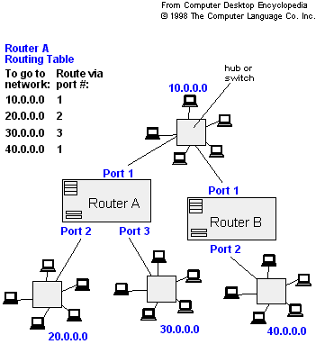
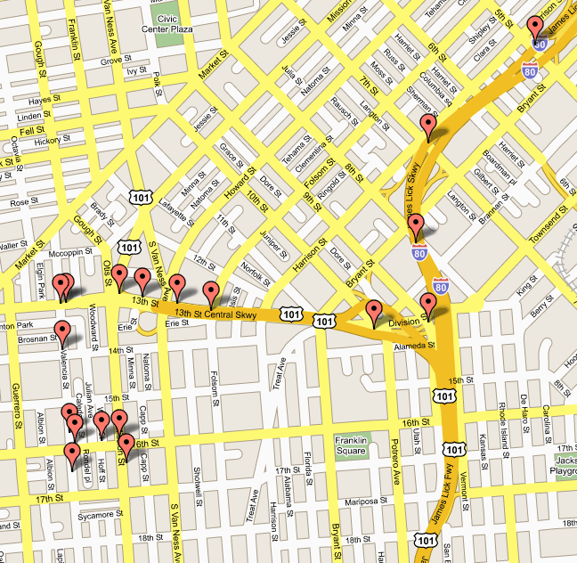
Applications of Dijkstra's Algorithm (CO5)
- Traffic Information Systems are most prominent use
- Mapping (Map Quest, Google Maps)
- Routing Systems

Slide 110
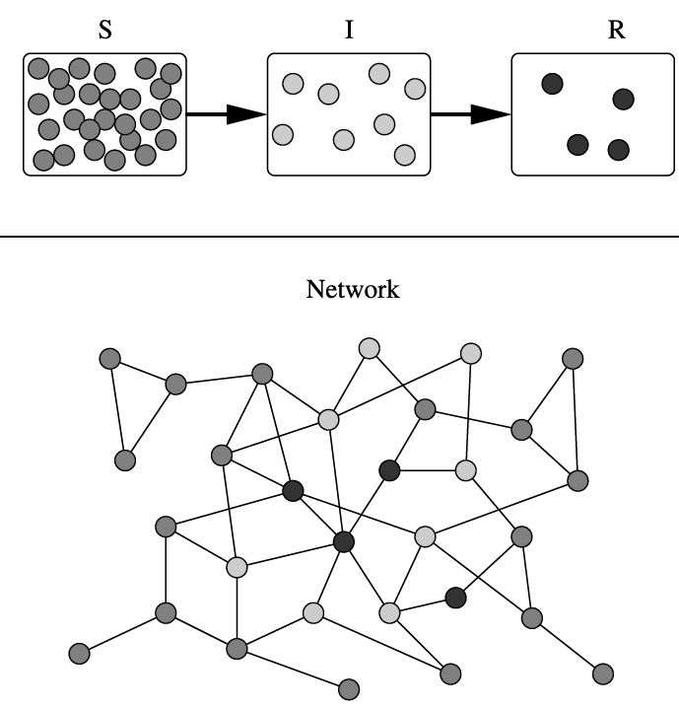
Applications of Dijkstra's Algorithm (CO5)
One particularly relevant this week: epidemiology
Prof. Lauren Meyers (MIT, Biology Dept.) uses networks to model the spread of infectious diseases and design prevention and response strategies.

Slide 111
Applications of Dijkstra's Algorithm (CO5)
Vertices represent individuals, and edges their possible contacts. It is useful to calculate how a particular individual is connected to others.
Knowing the shortest path lengths to other individuals can be a relevant indicator of the potential of a particular individual to infect others.

Slide 112
Floyd Warshall Algorithm (CO5)
Floyd Warshall Algorithm is a famous algorithm.
It is used to solve All Pairs Shortest Path Problem.
It computes the shortest path between every pair of vertices of the given graph.
Floyd Warshall Algorithm is an example of dynamic programming approach.

Slide 113
Floyd Warshall Algorithm (CO5)
Advantages-
Floyd Warshall Algorithm has the following main advantages-
It is extremely simple.
It is easy to implement.

Slide 114
Floyd Warshall Algorithm (CO5)
Floyd Warshall Algorithm is as shown below-
Create a |V| x |V| matrix // It represents the distance between every pair of vertices as given
For each cell (i,j) in M do-
if i = = j
M[ i ][ j ] = 0 // For all diagonal elements, value = 0
if (i , j) is an edge in E
M[ i ][ j ] = weight(i,j) // If there exists a direct edge between the vertices, value = weight of edge

Slide 115
Floyd Warshall Algorithm (CO5)
else
M[ i ][ j ] = infinity // If there is no direct edge between the vertices, value = ∞
for k from 1 to |V|
for i from 1 to |V|
for j from 1 to |V|
if M[ i ][ j ] > M[ i ][ k ] + M[ k ][ j ]
M[ i ][ j ] = M[ i ][ k ] + M[ k ][ j ]

Slide 116
Floyd Warshall Algorithm (CO5)
Time Complexity-
Floyd Warshall Algorithm consists of three loops over all the nodes.
The inner most loop consists of only constant complexity operations.
Hence, the asymptotic complexity of Floyd Warshall algorithm is O(n³).
Here, n is the number of nodes in the given graph.

Slide 117
Floyd Warshall Algorithm (CO5)
When Floyd Warshall Algorithm Is Used?
Floyd Warshall Algorithm is best suited for dense graphs.
This is because its complexity depends only on the number of vertices in the given graph.
For sparse graphs, Johnson’s Algorithm is more suitable.

Slide 118
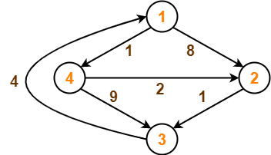
Floyd Warshall Problem (CO5)
Problem-
Consider the following directed weighted graph-
Using Floyd Warshall Algorithm, find the shortest path distance between every pair of vertices.

Slide 119
Floyd Warshall Algorithm (CO5)
Solution-
Step-01:
Remove all the self loops and parallel edges (keeping the lowest weight edge) from the graph.
In the given graph, there are neither self edges nor parallel edges.
Step-02:
Write the initial distance matrix.
It represents the distance between every pair of vertices in the form of given weights.

Slide 120
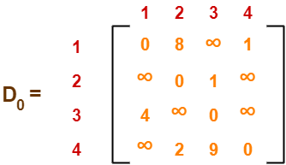
Floyd Warshall Algorithm (CO5)
Step-02: (Continue)
For diagonal elements (representing self-loops), distance value = 0.
For vertices having a direct edge between them, distance value = weight of that edge.
For vertices having no direct edge between them, distance value = ∞.
Initial distance matrix for the given graph is-

Slide 121
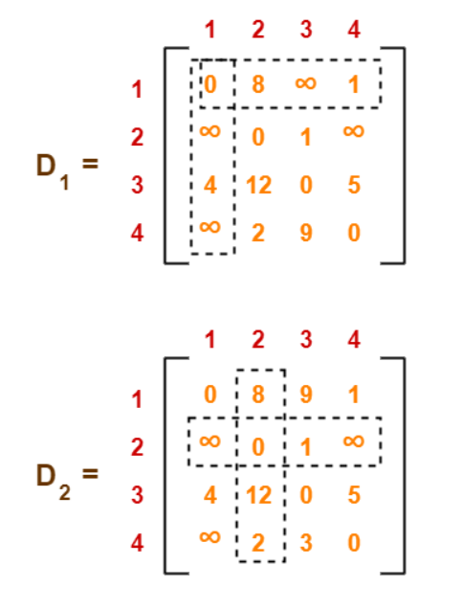
Floyd Warshall Algorithm (CO5)
Step-03:
Using Floyd Warshall Algorithm, write the following 4 matrices-

Slide 122
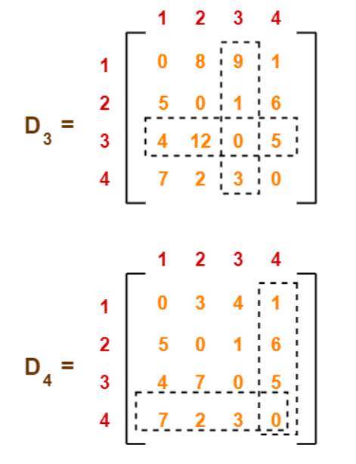
Floyd Warshall Algorithm (CO5)
Step-03:
The last matrix D₄ represents the shortest path distance between every pair of vertices.

Slide 123
Floyd Warshall Algorithm (CO5)
Remember-
In the above problem, there are 4 vertices in the given graph.
So, there will be total 4 matrices of order 4 x 4 in the solution excluding the initial distance matrix.
Diagonal elements of each matrix will always be 0.

Slide 124
Daily Quiz
Dijkstra’s Algorithm is used to solve _____________ problems. a) All pair shortest path b) Single source shortest path c) Network flow d) Sorting
2. Which of the following is the most commonly used data structure for implementing Dijkstra’s Algorithm? a) Max priority queue b) Stack c) Circular queue d) Min priority queue

Slide 125
Daily Quiz
3. Floyd Warshall’s Algorithm is used for solving ____________ a) All pair shortest path problems b) Single Source shortest path problems c) Network flow problems d) Sorting problems
4. Floyd Warshall’s Algorithm can be applied on __________ a) Undirected and unweighted graphs b) Undirected graphs c) Directed graphs d) Acyclic graphs

Slide 126
Faculty Video Links, Youtube & NPTEL Video Links and Online Courses Details
Youtube/other Video Links-
https://nptel.ac.in/courses/106/106/106106127/
https://nptel.ac.in/courses/106/106/106106145/

Slide 127
Daily Quiz
What are various file organization techniques?
How you can find number of shortest paths from source to destination using Dijkstra’s algorithm?
Suppose you are given a graph where each edge represents the path cost and each vertex has also a cost which represents that, if you select a path using this node, the cost will be added with the path cost. How can it be solved using Dijkstra’s algorithm?
Write the algorithm of Floyd Warshal all pair shortest path.
Write the algorithm for prims and Kruskal.

Slide 128
Daily Quiz
What do you mean by minimum spanning tree.
Define adjacency list and adjacency matrix.
Write the applications of graph.
9. Floyd Warshall Algorithm can be used for finding _____________ a) Single source shortest path b) Topological sort c) Minimum spanning tree d) Transitive closure

Slide 129
MCQs
Which of the following algorithms can be used to most efficiently determine the presence of a cycle in a given graph ?
a. Depth First Search
b. Breadth First Search
c. Prim's Minimum Spanning Tree Algorithm
d. Kruskal' Minimum Spanning Tree Algorithm
2. Traversal of a graph is different from tree because
a. There can be a loop in graph so we must maintain a visited flag for every vertex
b. DFS of a graph uses stack, but inorrder traversal of a tree is recursive
c. BFS of a graph uses queue, but a time efficient BFS of a tree is recursive.
d. All of above

Slide 130
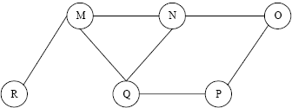
MCQs
3. What are the appropriate data structures for following algorithms?
Breadth First Search
Depth First Search
Prim's Minimum Spanning Tree
Kruskal' Minimum Spanning Tree
4. The Breadth First Search algorithm has been implemented using the queue data structure. One possible order of visiting the nodes of the following graph is

Slide 131
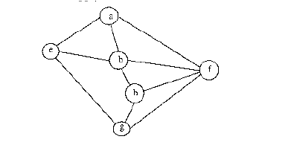
MCQs
5. Consider the following graph,
Among the following sequences:
(I) a b e g h f
(II) a b f e h g
(III) a b f h g e
(IV) a f g h b e
Which are depth first traversals of the above graph?
6. Given two vertices in a graph s and t, which of the two traversals (BFS and DFS) can be used to find if there is path from s to t?
Only BFS
Only DFS
Both BFS and DFS
Neither BFS nor DFS

Slide 132
MCQs
7. Which of the following is the most commonly used data structure for implementing Dijkstra's Algorithm?
a. Max priority queue
b. Stack
c. Circular queue
d. Min priority queue
8. What is the time complexity of Dijikstra's algorithm?
a. O(N)
b. O(N3)
c. O(N2)
d. O(logN)

Slide 133
MCQs
9. Which of the following condition is sufficient to detect cycle in a directed graph?
a. There is an edge from currently being visited node to an already visited node.
b. There is an edge from currently being visited node to an ancestor of currently visited node in DFS forest.
c. Every node is seen twice in DFS.
d. None of the above
10. Dijkstra's Algorithm is used to solve ..... problems.
a. All pair shortest path
b. Single source shortest path
c. Network flow
d. Sorting

Slide 134
MCQs
11. What procedure is being followed in Floyd Warshall Algorithm? a) Top down b) Bottom up c) Big bang d) Sandwich
12. Floyd- Warshall algorithm was proposed by ____________ a) Robert Floyd and Stephen Warshall b) Stephen Floyd and Robert Warshall c) Bernad Floyd and Robert Warshall d) Robert Floyd and Bernad Warshall

Slide 135
MCQs
13. Which of the following is false in the case of a spanning tree of a graph G? a) It is tree that spans G b) It is a subgraph of the G c) It includes every vertex of the G d) It can be either cyclic or acyclic
14. Every graph has only one minimum spanning tree. a) True b) False

Slide 136
MCQs
15. The Data structure used in standard implementation of Breadth First Search is? a) Stack b) Queue c) Linked List d) Tree
16. The Breadth First Search traversal of a graph will result into? a) Linked List b) Tree c) Graph with back edges d) Arrays

Slide 137
MCQs
17. Which of the following data structure is used to implement DFS? a) linked list b) tree c) stack d) queue
18. Which of the following traversal in a binary tree is similar to depth first traversal? a) level order b) post order c) pre order d) in order

Slide 138
MCQs
19. What is the time complexity of Dijikstra’s algorithm? a) O(N) b) O(N³) c) O(N²) d) O(logN)
20. Bellmann ford algorithm provides solution for ____________ problems. a) All pair shortest path b) Sorting c) Network flow d) Single source shortest path

Slide 139
Weekly Assignment
Q.1 Draw the complete undirected graphs on one, two, three, four and five vertices. Prove that the number of edges in an n vertex complete graph is
n ( n -1)/2.
Q.2 What are the different ways of representing a graph? Represent the following
graph using those ways.
Q.3 What are the different ways of representing a graph? Represent some graphs using those ways.

Slide 140
Weekly Assignment
Q.4 Write an algorithm which does depth first search through an un-weighted
connected graph. In an un-weighted graph, would breadth first search or depth
first search or neither find a shortest path tree from some node? Why?
Q.5 Which are the two standard ways of traversing a graph? Explain them with an example of each.
Q.6 Explain Dijkstra’s algorithm for finding the shortest path in a given graph.
Q.7 Write the short note on Tree Traversal.

Slide 141
Previous Year Questions
Explain warshall’s algorithm with the help of an example.
(AKTU SEM III 2019-20)
Describe the Dijkstra algorithm to find the shortest path.
(AKTU SEM III 2019-20)
How the graph can be represented in memory? Explain with suitable example.
(AKTU SEM III 2018-19)
Explain in detail about the graph traversal techniques with suitable examples.
(AKTU SEM III 2018-19)
Write algorithm for Floyd warshall algorithm, explain with a suitable example.
(AKTU SEM III 2017-18)

Slide 142
Expected Questions for University Exam
Define graph. How a graph is different from a tree?
Write Dijkastra algorithm for finding the shortest path from a source vertex.
Write the algorithm of floyd warshall. Also explain it with example.
Define connected graph and complete graph with example.
How the graph can be represented in memory? Explain with suitable example.
Explain Depth First Search Traversal in Graph with the help of an example.

Slide 143
Expected Questions for University Exam
7. Define Floyd Warshall Algorithm for all pair shortest path and apply the same on following graph:
8. Considering ‘S’ as source vertex, Apply the Dijkstra’s shortest path algorithm on the following graph:

Slide 144
Summary
File Organization refers to the logical relationships among various records that constitute the file, particularly with respect to the means of identification and access to any specific record.
Graph theory is an exceptionally rich area for programmers and designers.
Graphs can be used to solve some very complex problems, such as least cost routing, mapping, program analysis, and so on.
Network devices, such as routers and switches, use graphs to calculate optimal routing for traffic.

Slide 145
References
Aaron M. Tenenbaum, Yedidyah Langsam and Moshe J. Augenstein, “Data Structures Using C and C++”, PHI Learning Private Limited, Delhi India
Horowitz and Sahani, “Fundamentals of Data Structures”, Galgotia Publications Pvt Ltd Delhi India.
Lipschutz, “Data Structures” Schaum’s Outline Series, Tata McGraw-hill Education (India) Pvt. Ltd.
Thareja, “Data Structure Using C” Oxford Higher Education.
AK Sharma, “Data Structure Using C”, Pearson Education India.
Michael T. Goodrich, Roberto Tamassia, David M. Mount “Data Structures and Algorithms in C++”, Wiley India.
. P. S. Deshpandey, “C and Data structure”, Wiley Dreamtech Publication.

Slide 146
Thank You

